Slide 1
Electrical Power Prediction Md Jonybul Islam Qualification Project, Information and service system, Saarland university. Date: 30/06/2020
Presentation on

Slide 2
Overview
Problem Description
Dataset Description
Formulate Service Description and Business Idea
Preprocessing/Noise removal
Feature Engineering
Implement and Train Machine Learning Models
Test the Model
Visualize Results

Slide 3
Overview
Problem Description
Dataset Description
Formulate Service Description and Business Idea
Preprocessing/Noise removal
Feature Engineering
Implement and Train Machine Learning Models
Test the Model
Visualize Results

Slide 4
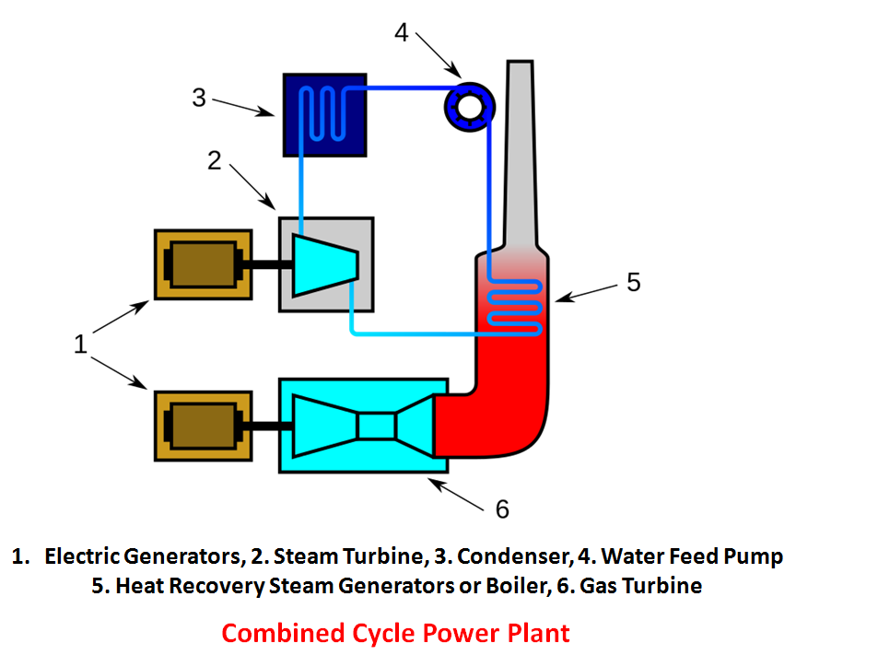
Problem Description
Electric power output in combined cycle power plant (CCPP).
Various parameters for load operation
Ambient Temperature (AT)
Atmospheric Pressure (AP)
Relative Humidity (RH)
Vacuum (Exhaust Steam Pressure, V)
Depending on parameters, we get Full Load Electrical Power Output (PE):

Slide 5
Overview
Problem Description
Dataset Description
Formulate Service Description and Business Idea
Preprocessing/Noise removal
Feature Engineering
Implement and Train Machine Learning Models
Test the Model
Visualize Results

Slide 6
Dataset Description
Consist of all the parameters described in real life.
Collected in six years period.
Parameters are selected based on the effect on electrical output.
Ambient Temperature (AT) measured in Celsius (C).
Atmospheric Pressure (AP) measured in Minibar (mbar).
Relative Humidity (RH) measured in percentage (%)
Vacuum (Exhaust Steam Pressure, V) measured in Centimeters Mercury (cm Hg)
Output Full Load Electrical Power Output (PE) measured in Mega Watt per hour (MW/h).

Slide 7
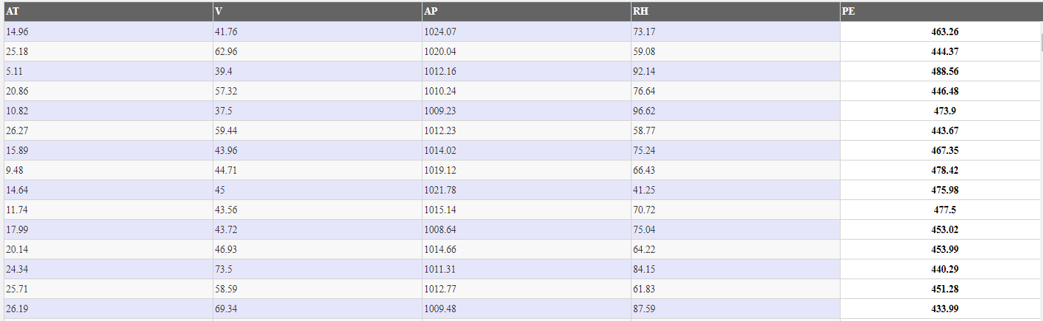
Dataset Preview

Slide 8
Overview
Problem Description
Dataset Description
Formulate Service Description and Business Idea
Preprocessing/Noise removal
Feature Engineering
Implement and Train Machine Learning Models
Test the Model
Visualize Results

Slide 9
Formulate Service Description and Business Idea
An algorithm that can predict electrical energy output (PE) with respect to inputs.
Lowest error rate.
Non tech user can easily get the output with the algorithm and intuitive visualization.

Slide 10
Overview
Problem Description
Dataset Description
Formulate Service Description and Business Idea
Preprocessing/Noise removal
Feature Engineering
Implement and Train Machine Learning Models
Test the Model
Visualize Results

Slide 11
Preprocessing/Noise removal
Dataset is already good enough curated.
Some basic conversion needed.

Slide 12
All others are in code and visualization.

Slide 13
Overview
Problem Description
Dataset Description
Formulate Service Description and Business Idea
Preprocessing/Noise removal
Feature Engineering
Implement and Train Machine Learning Models
Test the Model
Visualize Results

